Slide 1
The Coca-Cola AI Advertisement
The Ad And It’s Behind The Scenes

Slide 2
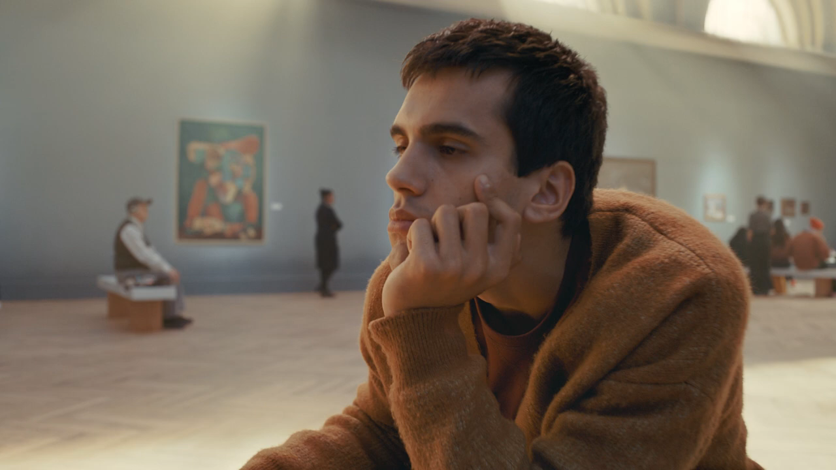

Slide 3
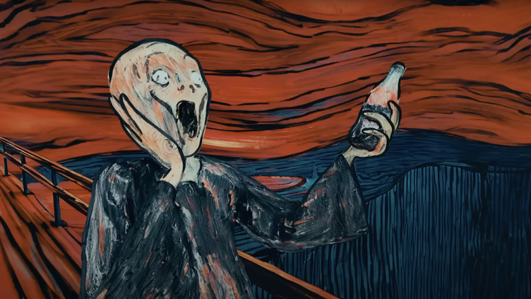
One of the drawings generated using Stable Diffusion

Slide 4
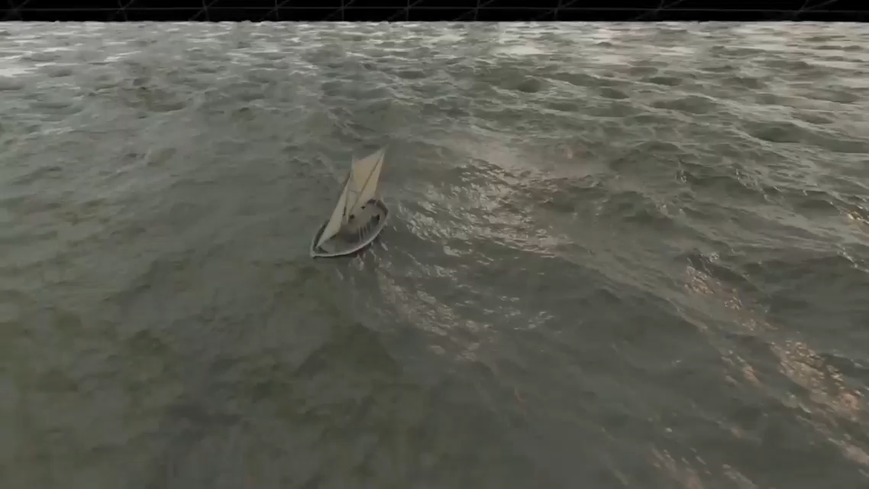

Slide 5
Thank You!

